Slide 1
Life Cycle of a Claim

Slide 2
Why Should We Care About the Life Cycle of a Claim?
The revenue cycle is the lifeblood of a healthcare organization
Without regular monitoring and adjustments, errors and inefficiencies will damage the financial stability and success of the organization, perhaps to the point of no return.
Ensuring an organization’s revenue cycle is operating accurately and efficiently will mitigate errors, thus preventing future denials or delays in payment.
Approved
Denied

Slide 3
Impact on Healthcare
Errors negatively impact hospitals and health systems in a number of ways as they often result in:
Re-Work for Business Office Staff
It typically costs $2–10 or more to re-bill a claim, with difficult issues leading to rework costs up to $25
Revenue Losses
Denial write-offs represent 1.7% of hospitals’ net revenue on average, not counting the cost of appealing denials
Patient Dissatisfaction
Billing delays and unexpected charges may cause patient confusion, affecting their perception of the organization
Notes:
There are two types of denial categories: Clinical and Technical
Clinical Denials occur when a claim fails to meet established coverage or the care does not meet the payer’s medical necessity criteria.
Technical (or Administrative) Denials occur when a claim does not have the required information or was filed incorrectly.
For an organization with a net patient revenue of $3.5B, denials equate to $42M in lost revenue.

Slide 4
Topic 1: Life Cycle of a Claim

Slide 5
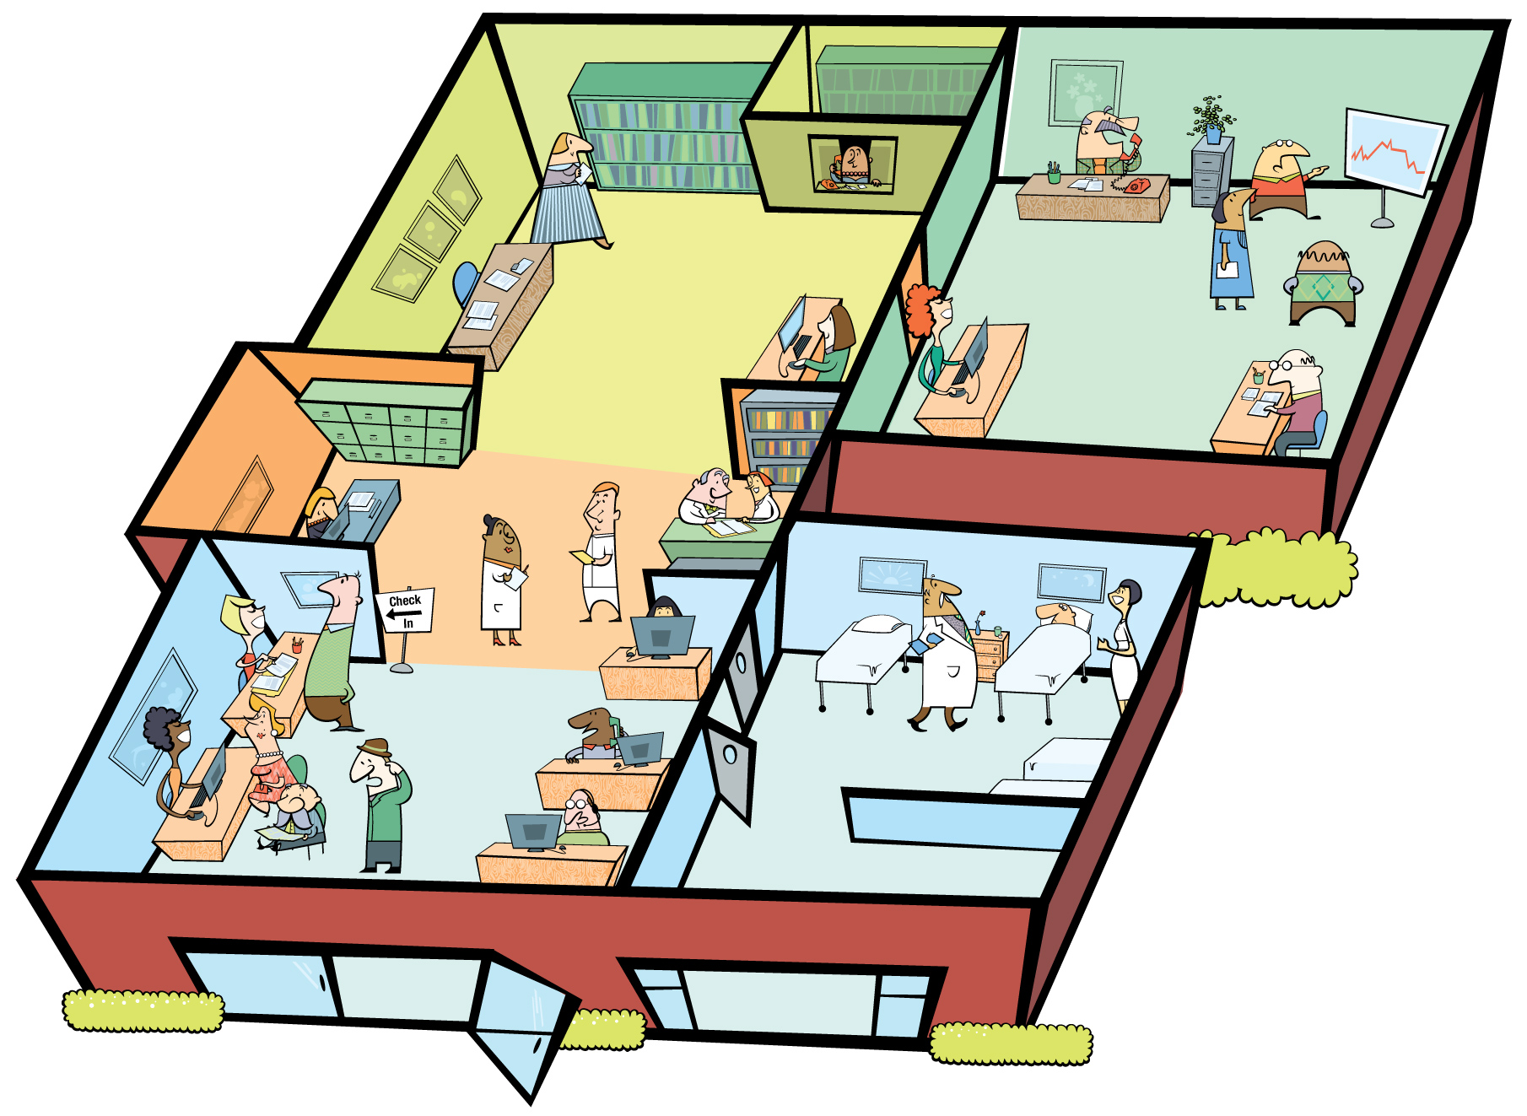
Main Areas of a Claim’s Life Cycle in a Hospital
Here’s what the life cycle areas look like in a hospital setting
Billing & Collections
Documentation, Coding, & Charge Capture
Scheduling & Registration

Slide 6
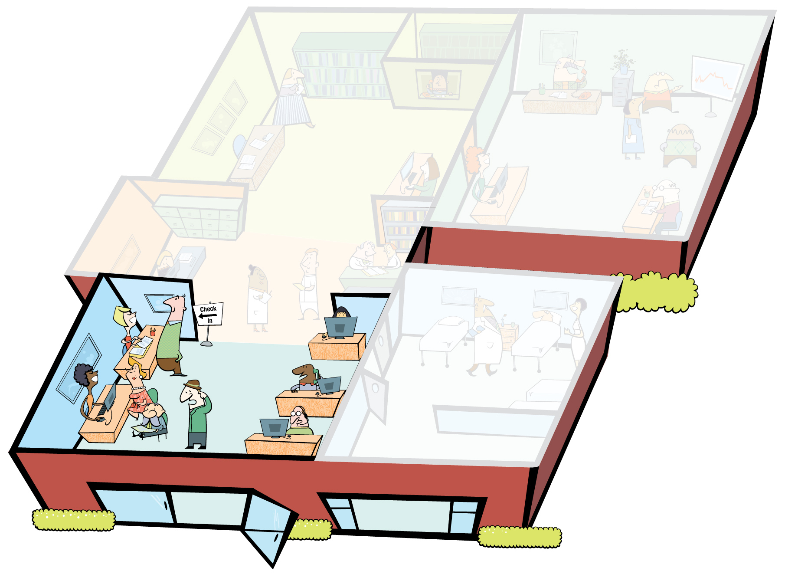
Main Areas of a Claim’s Life Cycle in a Hospital
Registration
The area in which patients are registered for services (can also be done over the phone). This is where patients provide demographic and insurance information that is used to begin the medical record for the service and create the bill. Registration is in the front-end of the revenue cycle, in Patient Access.

Slide 7
Main Areas of a Claim’s Life Cycle in a Hospital
Documentation, Coding, & Charge Capture
This is the revenue-generating portion of the life cycle. Once a patient receives care from doctors, nurses, and technicians, those services are recorded in the patient’s medical record. Each service has a special code and associated charge or cost, that is then added to the bill. Services, as well as equipment provided in operating rooms, patient rooms, emergency department, and lab and imaging, need charge capture and coding. This middle of the revenue cycle, also called “mid-cycle.”

Slide 8
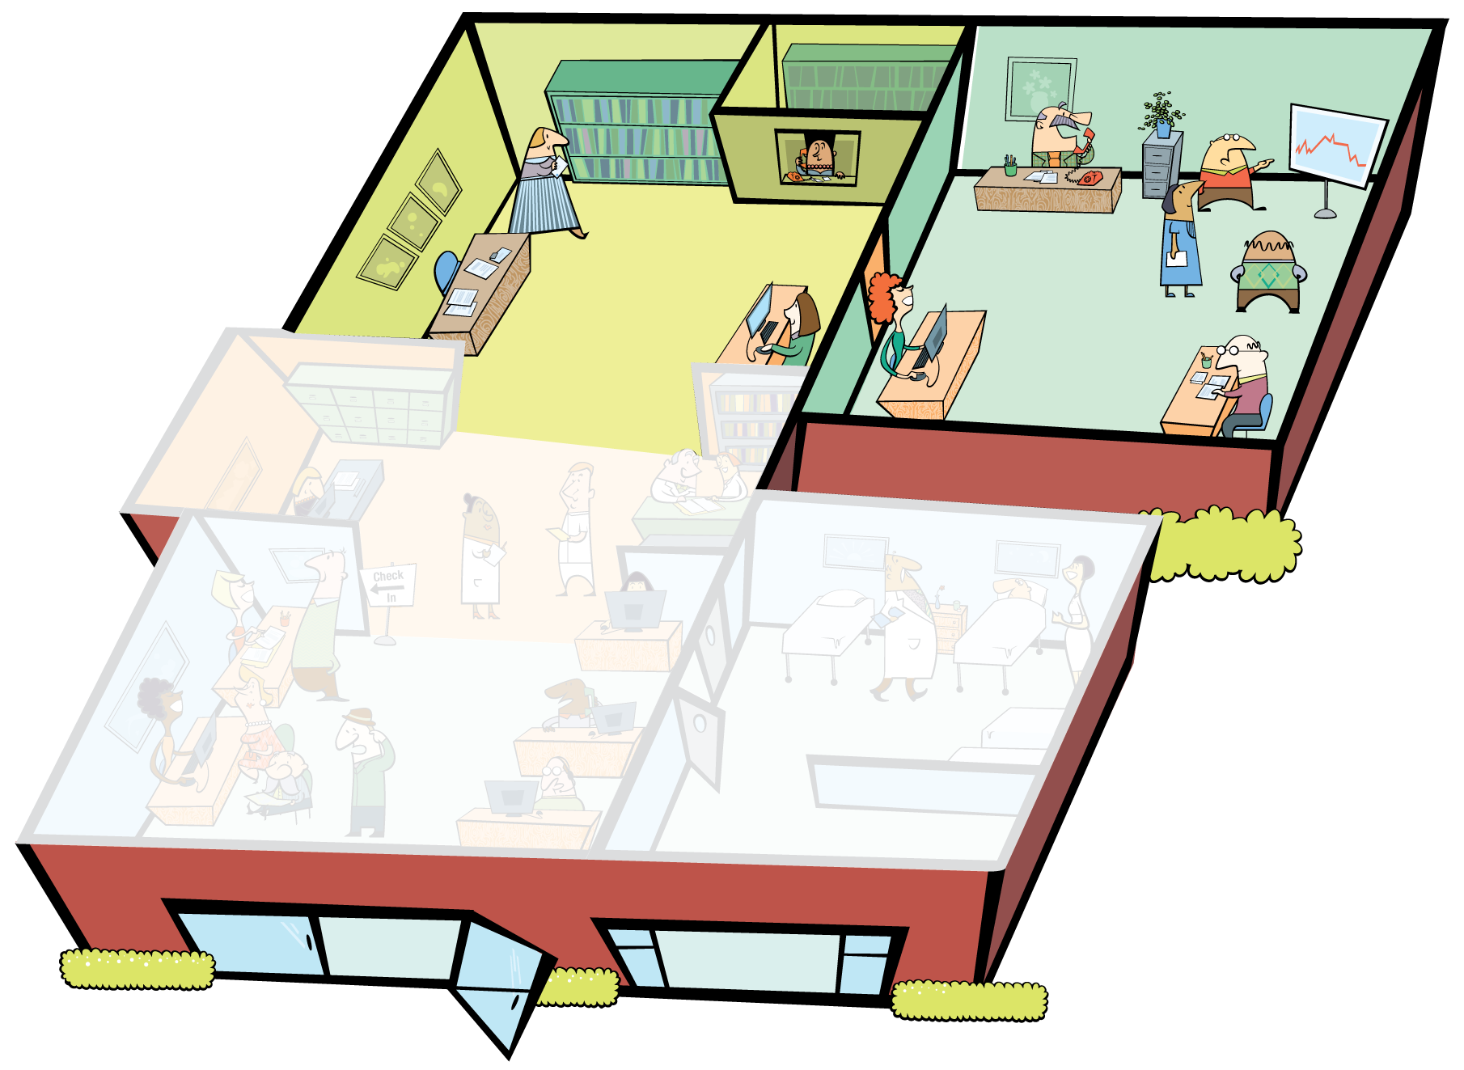
Main Areas of a Claim’s Life Cycle in a Hospital
Business Office
The area in which the administrative tasks of billing (submitting the claim to insurance or sending the bill to the patient), collecting and posting payments, following-up, and appealing underpayments and denials occurs. This is the back-end of the revenue cycle.

Slide 9
Topic 2: Front-End Functions
Front-End
Front Office Tasks
Patient Access (Scheduling, Pre/Registration, Insurance Verification)
Authorization
Utilization Management/Case Management
Mid-Cycle
Revenue-Producing Tasks
Clinical Documentation & Coding
Charge Capture
Charge Description Master Maintenance
Back-End
Back Office Tasks
Claim Generation
Claim Submission
Contract Management
Follow-Up
Payment Posting
Notes:
Some of the things I have specifically focused on since I have been in this position (CFO) are reducing the bad debt expense and improving the revenue cycle on the front end. I think a lot of hospitals focus their time and effort on the back end of the revenue cycle, in collections.
But, I am a firm believer in obtaining high-quality information up front. If we receive complete and proper information on the front end, from admitting to registration to clinical and case management, then the billing and collection staff have a much easier time getting out clean claims and collecting on them.”
Richard Davis, Chief Financial Officer, George Washington University Hospital, Washington, DC

Slide 10
Front-End: Patient Access
Stage by Stage
Patient Access
Authorization/Utilization Management
Clinical Documentation & Coding
Charge Description Master Maintenance
Charge Capture
Claim Generation
Claim Submission
Contract Management
Follow-Up
Payment Posting
Services are scheduled.
Patients are pre-registered or registered for services.
Critical Data Elements are collected and confirmed.
Insurance coverage verified.
Incorrect/incomplete information can lead to:
Inappropriate care and poor patient experience
Incorrect financial info leading to delay in payment and lack of insurance verification
Not being able to reach the patient after discharge, inability to collect patient liability
Required Elements for Commercial Claims
Patient name
Date of birth
Social Security Number (SSN)
Policyholder name and relationship to the patient
Policy group number (if applicable)
Pre-authorization number (if applicable)

Slide 11
Front-End: Patient Access
Schedulers and registrars begin the patient experience and the claim’s life cycle
This is the first and most important step in successfully converting a patient’s account into cash.
Understanding the issues behind individual patient’s insurance benefits and the insurance cards that are carried by the patient is crucial to a successful verification process.
Ex: Cost to Correct Error in Terms of Employee Wages
$10/hour x 6 hours of work per claim to recoup funds x 100 claims per month = $6,000
$6,000 x 12 months = $72,000 per year, per back-end employee
$72,000 x 5 back-end team members = $360,000 per year
Notes:
Deeper dive: Collecting and Verifying Insurance Information Training Presentation.pdf

Slide 12
Front-End: Utilization Management
Stage by Stage
Patient Access
Authorization/Utilization Management
Clinical Documentation & Coding
Charge Description Master Maintenance
Charge Capture
Claim Generation
Claim Submission
Contract Management
Follow-Up
Payment Posting
Also known as Case Management or Utilization Review.
These teams have one foot in revenue cycle administration and one in clinical quality – they work to help ensure patients meet the qualifications for certain services, and help review clinical appeals.
Primary insurance is notified of patient admission.
Could happen during pre-services or when patient arrives.
Insurance is contacted when services are scheduled to obtain pre-authorization or pre-certification
If not obtained prior to admission, necessary authorization for services is requested of insurance
Medical necessity of services and length of stay is evaluated throughout patient’s stay to ensure that authorization accurately includes entirety of patient’s care.

Slide 13
Front-End Denials
The accuracy, completeness, and timeliness of front-end processes can improve an organization’s ability to submit clean claims.
HBI Revenue Cycle Academy data indicates that the top-reported root cause for denials is No Authorization/Incorrect Authorization.
If an organization averages $3.5B in Net Patient Revenue per year, authorization-related denials represent approximately $9M in lost revenue.
It is important for patient access staff to:
Record complete and accurate patient information
Verify insurance eligibility and benefits in advance of service
Obtain prior authorizations and pre-certifications required by payers in a timely manner
Ensure medical necessity of pre-auth is supported by proper documentation
Collaborate with business office staff to identify and proactively address common errors leading to denials

Slide 14
Topic 3: Mid-Cycle Functions
Front-End
Front Office Tasks
Patient Access (Scheduling, Pre/Registration, Insurance Verification)
Authorization
Utilization Management/Case Management
Mid-Cycle
Revenue-Producing Tasks
Clinical Documentation & Coding
Charge Capture
Charge Description Master Maintenance
Back-End
Back Office Tasks
Claim Generation
Claim Submission
Contract Management
Follow-Up
Payment Posting

Slide 15
Mid-Cycle: Clinical Documentation & Coding
Stage by Stage
Patient Access
Authorization/Utilization Management
Clinical Documentation & Coding
Charge Description Master Maintenance
Charge Capture
Claim Generation
Claim Submission
Contract Management
Follow-Up
Payment Posting
Nurses and doctors record all diagnoses, procedures, supplies used, and drugs administered in the patient’s medical records, including special circumstances that would later warrant additional explanation through coding modifiers.
Each diagnosis, procedure, and supply documented is translated into a corresponding code.
Those codes are placed on the UB-04 and layer processed for payment by the insurance company.
Common illegal pitfalls include “upcoding” and “downcoding”—manipulating codes on a claim to reflect services that garner a higher reimbursement when those services did not actually take place.

Slide 16
Mid-Cycle: Clinical Documentation & Coding
Little modifiers create big problems
A common oversight in coding is the addition of modifier codes to the claim.
According to Noridian (Medicare Fiscal Intermediary):
Modifiers can be two digit numbers, two character modifiers, or alpha-numeric indicators. Modifiers provide additional information to payers to make sure your provider gets paid correctly for services rendered.
In claims processing, many errors stem from the lack of necessary surgical modifiers.
These modifiers are added as the 6th and 7th digits of a CPT Code.
Common surgical CPT modifiers include:
Modifier | Definition
21 | Usage and Reimbursement; used when the face-to-face service provided is prolonged or otherwise greater than usually required for the highest level of evaluation and management (E&M) service within a given category.
50 | Bilateral Procedures; used when the same procedure is performed on both limbs (hands, arms, legs, feet)
51 | Multiple Procedures; used when multiple surgeries are performed in the same session by the same provider.
LT | Left; often accompanies Mod 50 and indicates the procedure was performed on the left-side body part
RT | Right; often accompanies Mod 50 and indicates the procedure was performed on the right-side body part
Notes:
Deeper dive: connect to Properly Applying CPT Code Modifiers.pdf

Slide 17
Mid-Cycle: Clinical Documentation & Coding
Potential pitfalls
Essential to the claim process, documentation and coding ultimately determine the supplies and procedures that an organization can bill.
Mid-cycle functions impact whether a provider will receive proper reimbursement from third party payers. They can also improve patient satisfaction.
According to industry reports, some of the most frequent denial reasons include coding edits and medical necessity issues, indicating the importance of careful coding and clinical documentation improvement (CDI) processes.

Slide 18
Mid-Cycle: Charge Description Master Maintenance
Stage by Stage
Patient Access
Authorization/Utilization Management
Clinical Documentation & Coding
Charge Description Master Maintenance
Charge Capture
Claim Generation
Claim Submission
Contract Management
Follow-Up
Payment Posting
Think of this as the facility’s “menu.”
The Charge Description Master (CDM) is a list of all supplies and services the hospital bills. It maps each charge to the appropriate revenue code and charge amount.
Proper maintenance of this list will help ensure that bills are coded with the information needed to receive proper payment.
Common Issues:
List is hard to maintain: thousands of codes, codes with no monetary value, very little organized maintenance
Duplicate entries
If a charge is mapped to the incorrect revenue code the hospital is at risk for not receiving proper reimbursement for the item or service
Notes:
McDonalds:
big mac, large fries, large coke
Each of those items has it’s own code indivudally, the employee doesn’t type in “large fries” each time, they’ll punch in a code. That code shows the item, fries, and the price, $2.00.
But what if the system showed the wrong price because it wasn’t updated with the last price increase from corporate? Mickey D’s misses out on the extra reimbursement.
When new items are added – the code list is updated, the menu is updated. If But what if those items have already been added and now there’s a duplicate? And what if those duplicates have different prices? It can create a lot of confusion.
What about ketchup packets? Those are “not separately payable”, or considered to be included in the cost of everything else. Kind of like certain supplies like bandaids or drugs like Tylenol. They aren’t “separately payable” either.

Slide 19
Mid-Cycle: Charge Description Master Maintenance
CDM: Incorrect Mapping Example
Proper Revenue Code Assignment
Sample CDM with Incorrect Mapping
Service Code | Description | Revenue Code | CPT | Price
1100111 | Steel Plate 6”x4” | 272 |  | $1,000
1100112 | Steel Rod 1”x8” | 278 |  | $1,200
1100113 | Pacemaker | 272 |  | $10,000
1100114 | Gauze | 272 |  | $10
7789904 | Tylenol 200mg tablet | 250 |  | $25
7789905 | Ibuprofen 200mg tablet | 250 |  | $25
7789906 | Morphine 1mg injection | 250 | J2270 | $1,500
7789907 | Ondansetron 1mg injection | 636 | J2405 | $1,500
Revenue Code | Description
278 | Implant
275 | Pacemaker
272 | Sterile Supply
250 | Pharmacy
636 | Drugs with Detailed Coding
Contracted Reimbursement Rate for RC 275: 60% of Charges
Contracted Reimbursement Rate for RC 272: Not Carved Out, included in Per Diem Rate
Missed RC 275 Reimbursement: $6,000
Notes:
Talk through the inconsistencies represented by the slide.

Slide 20
Mid-Cycle: Charge Capture
Stage by Stage
Patient Access
Authorization/Utilization Management
Clinical Documentation & Coding
Charge Description Master Maintenance
Charge Capture
Claim Generation
Claim Submission
Contract Management
Follow-Up
Payment Posting
All billable items and services that were documented in the medical records are added to the UB-04 with the help of the Charge Description Master.
Charges translate into revenue. Without accurate charges, the facility cannot get properly reimbursed for services rendered.
Many commercial contracts are moving to Percent of Charge reimbursement. If the service should be billed for $100 and only $50 makes it to the claim, the facility has missed out on half the reimbursement that is really due.
Sometimes procedures, room charges, and supplies are forgotten or mistakenly left off the bill, resulting in the billing of a corrected claim with added “late charges”, or worse, charges never being billed and thus never getting reimbursed.

Slide 21
Mid-Cycle: Charge Capture
Sometimes charges don’t make it to the bill
As the patient receives care, charges are added to the bill from several different departments that participate in the care plan.
Radiology Lab
Medical/ Surgical Unit
Emergency Department
Operating Room

Slide 22
Mid-Cycle Denials
When assessing the root causes of denials, HBI has found that coding and documentation account for about 10% of denials.
Revenue integrity staff can improve the claim process by:
Ensuring they understand system processes
Answering staff questions
Conducting frequent reconciliations
Regularly reviewing the charge description master
Incorporating regulatory updates in a timely manner
Physicians can help keep denials from happening by:
Improving timeliness by submitting charts within designated timeframes
Clearly documenting medical necessity, responding to queries, and using templates to meet payer criteria
Assisting in denials efforts by writing appeal letters or engaging in peer-to-peer reviews
The sooner charges are entered, the sooner the claim can be coded, billed, and paid.
Consider starting the process of rebilling right away as doing so may keep the patient from receiving an inaccurate bill.
Characteristics of Quality Clinical Documentation
Legible: easily read
Complete: thorough content
Clear: follows an unambiguous thought process
Consistent: not contradictory
Precise: exact & strictly defined
Reliable: supports patient safety
Timely: meets organizational and regulatory deadlines

Slide 23
Topic 4: Back-End Functions
Front-End
Front Office Tasks
Patient Access (Scheduling, Pre/Registration, Insurance Verification)
Authorization
Utilization Management/Case Management
Mid-Cycle
Revenue-Producing Tasks
Clinical Documentation & Coding
Charge Capture
Charge Description Master Maintenance
Back-End
Back Office Tasks
Claim Generation
Claim Submission
Contract Management
Follow-Up
Payment Posting

Slide 24
Back-End: Claim Generation
Stage by Stage
Patient Access
Authorization/Utilization Management
Clinical Documentation & Coding
Charge Description Master Maintenance
Charge Capture
Claim Generation
Claim Submission
Contract Management
Follow-Up
Payment Posting
The UB-04 now has all of the information it should need to be officially generated and passed through the system’s claim scrubber to check for errors (conflicting HCPCS, missing information).
The scrubber will either allow the claim to go through to the next step, Claim Submission, or be flagged for additional work.

Slide 25
Back-End: Claim Submission
Stage by Stage
Patient Access
Authorization/Utilization Management
Clinical Documentation & Coding
Charge Description Master Maintenance
Charge Capture
Claim Generation
Claim Submission
Contract Management
Follow-Up
Payment Posting
The claim is submitted to the appropriate payer (determined through Patient Access Insurance Verification) electronically or through paper-mail and within the timely filing limit set forth in the contract or federal mandate.
Issues arise when:
The claim is automatically rejected from an electronic clearinghouse due to improper coding or missing information
Paper claims get lost in the mail or delivered to the wrong department
The claim isn’t received within the timely filing limits
Notes:
Before a claim is submitted, billers can do the following the help reduce denials:
Re-verify pre-authorization numbers
Confirm clinical documentation is complete and supports medical necessity
Ensure all required attachments are included
Keep note of payers’ timely filing deadlines—untimely billing may result in a denial for an otherwise error-free claim
Deeper dive: connect to Considerations for Successfully Insourcing or Expanding Billing Operations.pdf

Slide 26
Back-End: Contract Management
Stage by Stage
Patient Access
Authorization/Utilization Management
Clinical Documentation & Coding
Charge Description Master Maintenance
Charge Capture
Claim Generation
Claim Submission
Contract Management
Follow-Up
Payment Posting
The appropriate contract for the responsible payer and plan type (determined through Patient Access Insurance Verification) is loaded to the account’s profile to calculate an expected reimbursement.
The patient’s particular plan will also play a role in determining how a claim will be processed and paid, and plan documents may require review to ensure proper payment.
Patient Accounting representatives should be well versed in contract terminology, rates, and processing requirements and deadlines in order to ensure accuracy.
Problems arise when:
The wrong payer or plan type is loaded to the account, thus calculating an incorrect expected payment due
Appeals staff do not have access to contracts to research potential underpayments

Slide 27
Back-End: Follow-Up
Stage by Stage
Patient Access
Authorization/Utilization Management
Clinical Documentation & Coding
Charge Description Master Maintenance
Charge Capture
Claim Generation
Claim Submission
Contract Management
Follow-Up
Payment Posting
Now that the claim has been submitted, processing status checks must be performed:
Confirm receipt of the claim to ensure it is in process.
Ensure the payer has all necessary information to properly process the claim within the expected time frame, and send additional information (invoices, itemized bills, medical records, authorization) if requested. Confirm receipt of these materials one week after they are sent.
Compare the received payment to the contract rates loaded during the Contract Management phase.
If payment does not equal the expected amount, contact the payer to learn how the claim was processed, determine whether or not charges/services were denied, verify the correct contract was loaded to the account, and appeal underpayments/denials.

Slide 28
Back-End: Follow-Up
Follow-up is costly in both time and expense
Follow-up may require several different forms of contact with the payer:
Phone call to confirm of receipt of documents, request information on how a claim was processed, or send claim back for additional review
Fax of additional requested information
Mailing of appeal letters
Checking payer websites for updated claim status
Each form takes significant time:
Hold times to speak with payer representative are often > 30 minutes
Reviewing accounts to gain life cycle understanding and compare amount paid to amount due can take 5–60 minutes, depending on account complexity
Compiling documents for fax and writing appeals can take 10+ minutes, or even days, and involve multiple people and departments
Follow-up tasks cost a lot of money, and pursuit of underpayments may not be worth the time.
Patient Accounting departments must take into account the underpayment amount and how much time it would take to resolve a low balance account.
If the wages paid for the time spent on underpayment pursuit are greater than the underpayment, the account is not worth pursuing.

Slide 29
Back-End: Payment Posting
Stage by Stage
Patient Access
Authorization/Utilization Management
Clinical Documentation & Coding
Charge Description Master Maintenance
Charge Capture
Claim Generation
Claim Submission
Contract Management
Follow-Up
Payment Posting
When follow-up efforts are complete or exhausted, the payment and necessary adjustments are posted to the account profile to move the balance to zero, or transfer the balance to the next responsible party (secondary insurance, patient) for billing.
Issues arise when:
Payment posting does not happen in a timely manner, leaving resolved accounts in open AR or delaying the billing of the next responsible party
Payment/adjustment posting is incorrect
Credit balances are not tended to
Notes:
Errors in posting payments can cause accounts to remain in open A/R for months
Many facilities within organizations post payments and adjustments differently:
Some post contractual adjustments at the time of billing, netting the balance down to the expected amount before the claim is processed by the payer.
Some post contractual adjustments when the claim is processed and payment is remitted (whether a zero pay or not).
Types of adjustments:
Automatic Adjustments: programmed in the system to apply the contracted amount due to the account profile based on the contract and plan type loaded.
Manual Adjustments: patient accounting representatives log payments and adjustments by hand when remittance is received or when the account is written off.
Write-offs:
Claims that cannot be properly resolved are typically written off in order to close out Open AR. There are four main kinds of write-offs:
Charity Care: when the patient is unable to pay his/her portion of the claim due to financial instability
Bad Debt: when the patient is financially able to pay his/her portion of the claim but refuses to do so
Denial: when the payer refuses to pay the claim at the contracted rate and all appeals efforts have been exhausted
Administrative: when a settlement has been reached that has altered the amount due with a one-time agreement between the facility and the responsible party

Slide 30
Back-End: Patient Account Representatives
The back-end of the revenue cycle is the last line of defense against errors or issues that impede claims resolution.
This is where all rework starts. The most time consuming activity is researching claims that are not paid as expected and determining how to correct the issue.
Back-end staff catch the errors that were made in every preceding stage.
What’s the Cost?
3,600 accounts to research and resolve per year
10 Full Time Employees (FTE’s) work denials/underpayments
1 FTE can work 15 accounts per day; 150 worked by team per day
1 FTE works 8 hours per day and earns $10 per hour; Team Wages = $800 per day
3,600 accounts / 150 accounts worked per day = 24 days worth of work
24 days x $800 wages = $19,200 spent just on correcting errors per team per month
$19,200 x 12 months = $230,400 spent per year on trying to correcting errors

Slide 31
Back-End Denials
Timeliness is key when conducting back-end functions like claim submission and follow-up.
To help facilitate proper and efficient claims processing, billers need to be familiar with timely filing stipulations and required documentation dictated by the contract.
HBI recommends a standard best practice that follow-up representatives maintain an efficient work queue and confirm receipt of all submitted materials (whether electronic or paper mail) within one week of submission, as well as calling the payer at least every 30 days to check the status of the claim in process.
Familiarity with contract language and the claim’s expected reimbursement will help representatives understand whether or not a claim was paid correctly or if an underpaid or denied claim should be appealed. Appeals also are subject to timely filing limits, so reviewing payments and tending to balances as soon as correspondence is received is critical in receiving proper payment.
Understanding all stages of the revenue cycle and in which stage/department certain tasks take place will help Patient Accounting representatives and other back-end staff request and obtain any additional information or edits that must take place on the claim in order to get it processed correctly.

Slide 32
Conclusion

Slide 33
The Revenue Cycle: Recap
Complexities in the Process
The revenue cycle is extremely complex involving staff and technology across various departments that support revenue cycle process, which ultimately impacts the patient and physician experience, and causes loss of revenues.
Work Flow Automation
Charges missed due to inaccurate CDM
Paper-based process creates numerous inefficiencies
Shortage of skilled personnel and manual processes prevent timely DNFB reduction
Treatment provided but changes not captured correctly
Archives often not maintained
Re-bills often sent 60 days or more after denials
Treatment authorization not received prior to service
Clinical document may be inadequate and not make case for medical necessity
Clean Claims Archived
Auto Refill
Second claims often sent 60–90 days after original claim creating cash flow deficiency
Pre-Admit
Discharge
HIM
Admit
PAS
Clean Bill Drops
EDI Submit
Claims Status
Payer Remittance Post
Second Payer EDI Submit
Management Reports
Feedback
Denial Management
Contract Management Payment Calculations
Insurance not verified
Accounts without insurance registered as private pay when Medicaid or Charity Care is available
Check for secondary insurance not made
Incorrect private billing class assignment
Pre-certification, additional insurance, and demographic information improperly captured
Pre-certification requirements ignored
Transcription delays prevent timely coding
No linkage from bill system back to PAS
Collection efforts focus on large accounts only with little effort on ensuring high volume, small balance OP accounts are paid accurately
Contract Management often not linked to overall process
Expected Payment not calculated accurately, yielding inaccurate AR balances
No process platforms or technology to track or monitor denials and root cause
Often no means of identifying claim status
Reports often fragmented, not providing meaningful information
Database often exist is silos
Reports are not cash focused
Lack of cash collection/under payment reports
Lack of resource optimization
Legacy-based platforms with poor integration creates problems
Bill holds and backlogs in HIM and front-end process
Late/missing charges create financial problems
Information Collected
Clinical Care Provided
Payer Billed
Hospital Paid
$$
Patient Clinician, and Payer Touch Points

Slide 34
Conclusion
Claims are the means through which organizations request and receive payment, making it important that they are properly populated, edited, and submitted.
The life of a claim encompasses the entire revenue cycle, from the collection of patient information in Patient Access and proper documentation and coding conducted mid-cycle, all the way to claim submission and follow-up within billing and collections.
Every staff member plays a key role in not only claim success, but also to the organization’s financial well-being.
Approved
Denied

